Slide 1
Strength of Materials
Module 4 – Beam
(stresses in beam)
Dr. G.Venkatachalam
Professor / SMEC
VIT Chennai Campus
Chennai

Slide 2
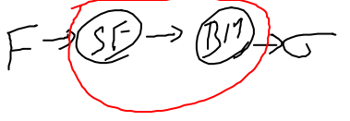
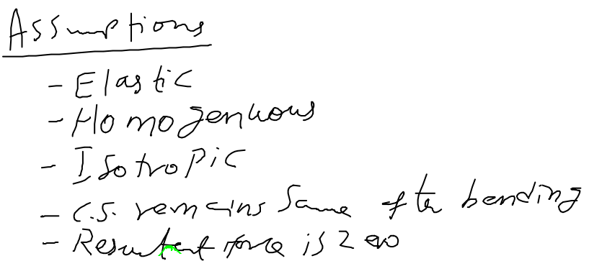
Discussed in module 3
Beam theory

Slide 3
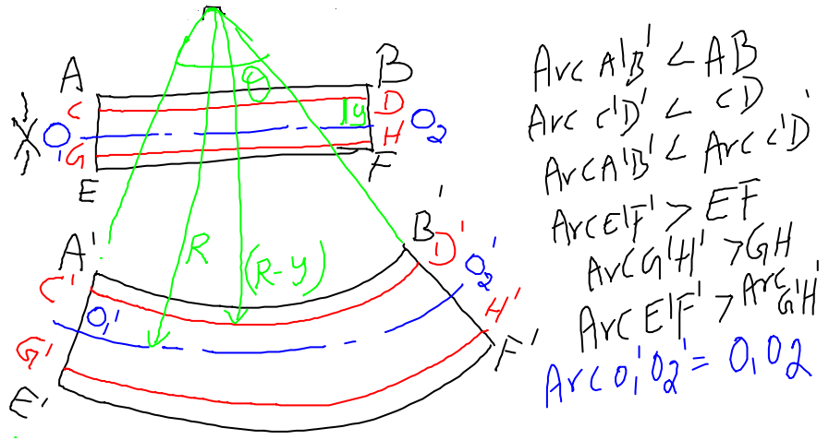
Before bending
O₁O₂ – no change in dimension – hence no stress / no strain – neutral axis or neutral plane
After bending

Slide 4
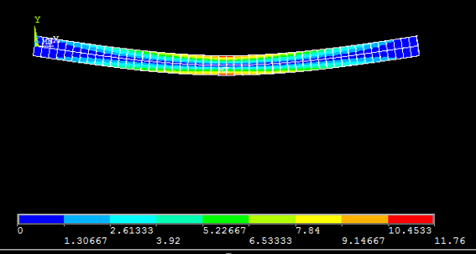

Slide 5
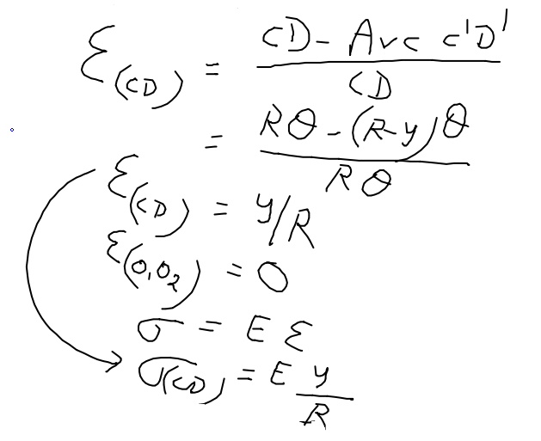
Strain / stress in the layer CD
y = Distance of layer CD from neutral axis / plane
R = radius of curvature

Slide 6
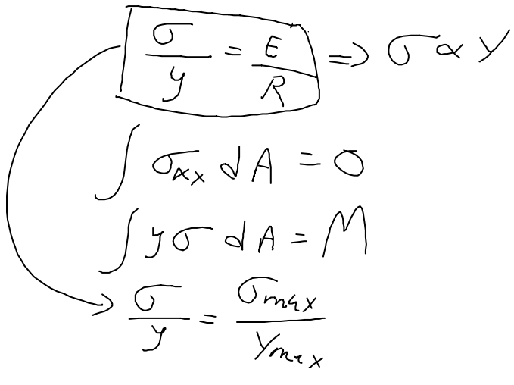
Resultant force is zero
Ratio is constant

Slide 7
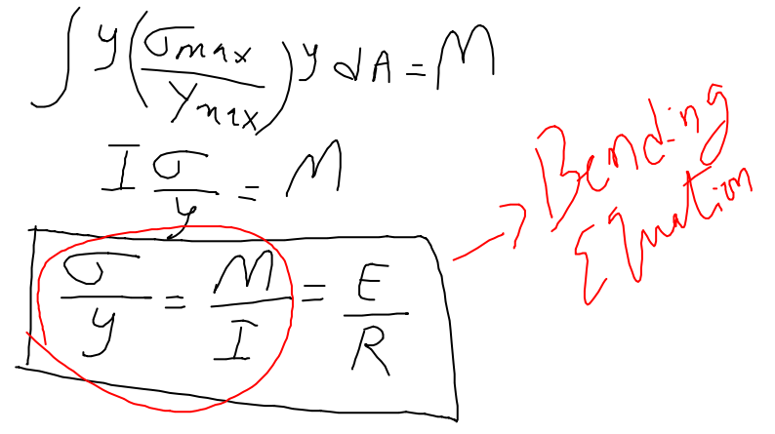
σ – stress; y – distance from neutral axis; M- bending moment; I – moment of Inertia; E – Young’s modulus; R – radius of curvature

Slide 8
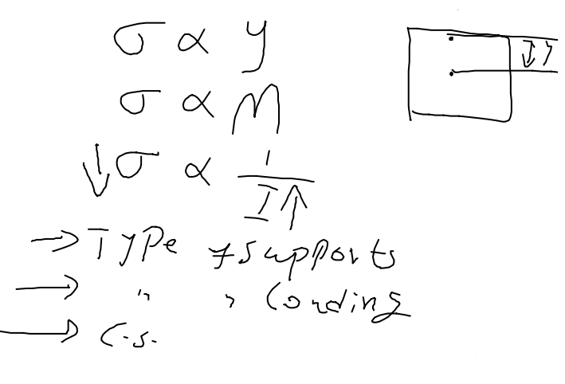
Importance of moment of inertia

Slide 9
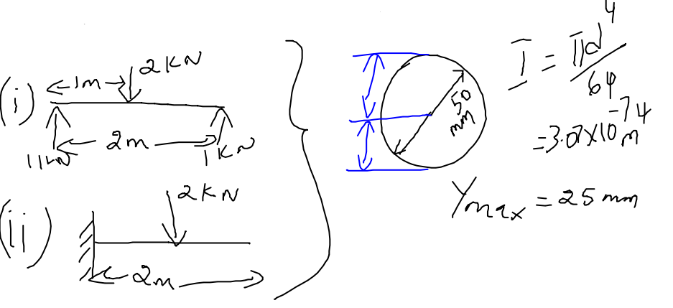
Influence of type of support on stress

Slide 10
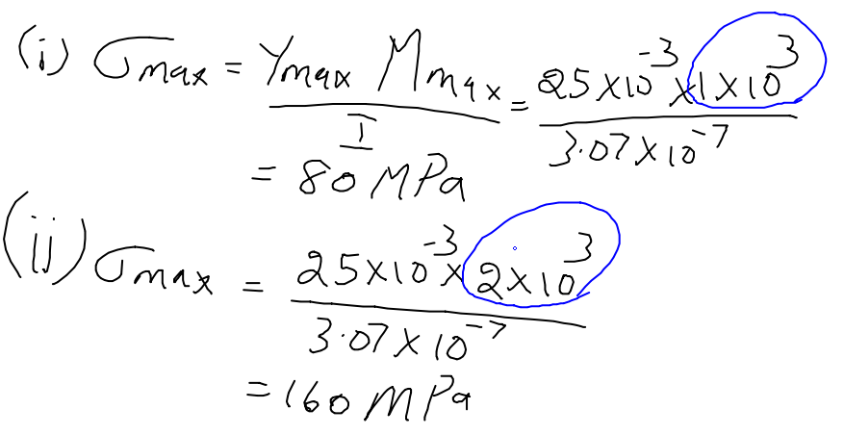
M_{max} – already discussed in module 3
Conclusion: less stress in simply supported beam because of low bending moment

Slide 11
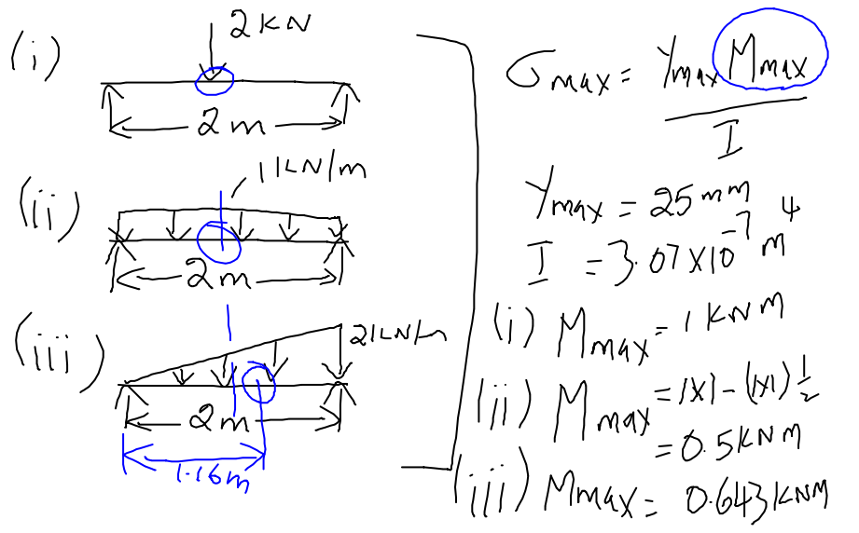
Influence of type of loading on stress
Max stress location in all 3 beams

Slide 12
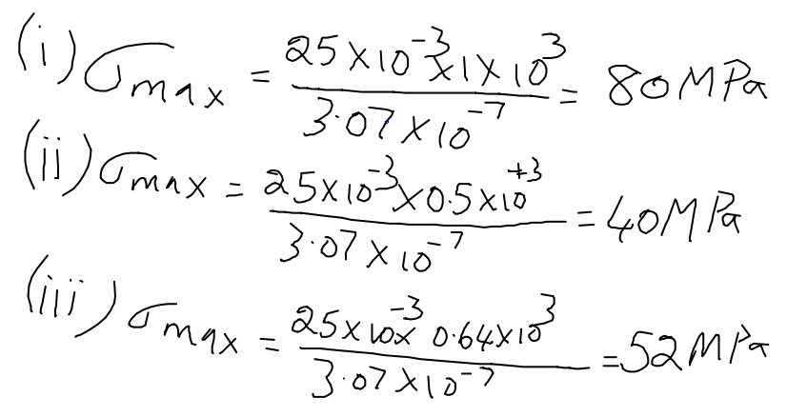
Conclusion: less stress in UDL beam – load is distributed uniformly

Slide 13
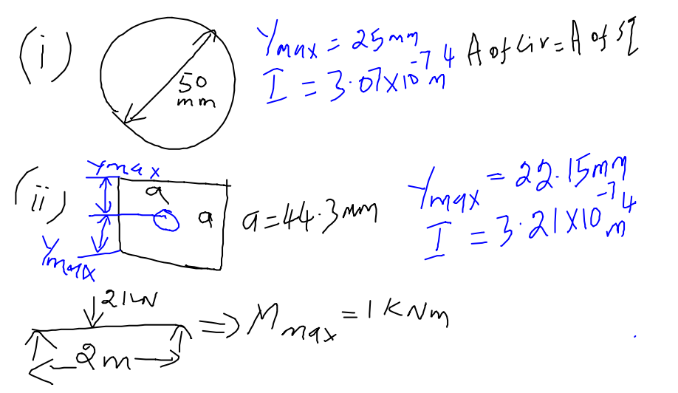
Same area but “I” is different
Influence of cross section on stress

Slide 14
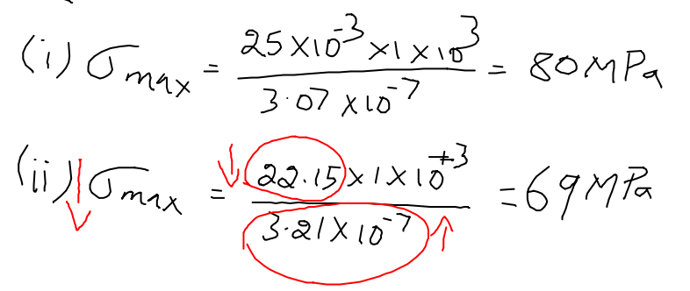
Conclusion: less stress in square CS beam – but sharp corners invite stress concentration effects

Slide 15
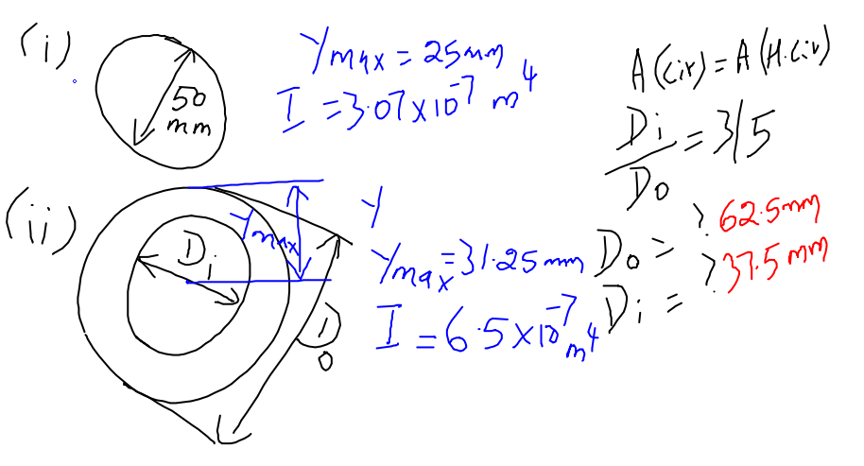
Influence of circular & hollow circular cross section on stress
Same area but “I” is different

Slide 16
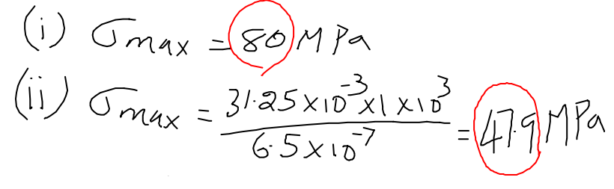
Conclusion: Hollow circular CS is preferred over circular – only concern is “manufacturing aspect”

Slide 17
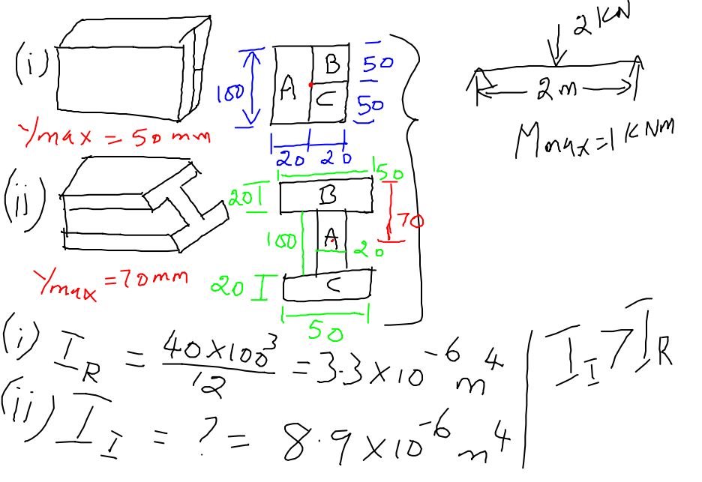
Advantage of using “I” cross section beam
Same area but “I” is different

Slide 18
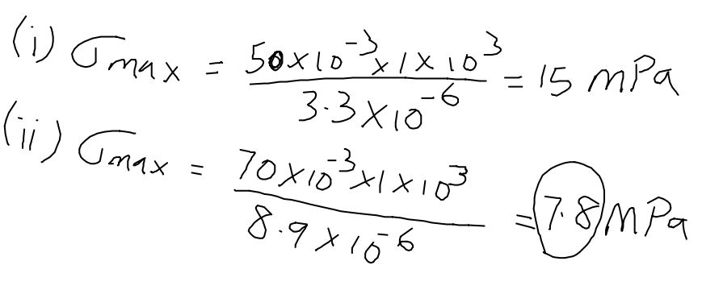
Conclusion: stress is almost “half” of rectangle – “I” CS is preferred – railway lines “I” CS – to minimize stress

Slide 19
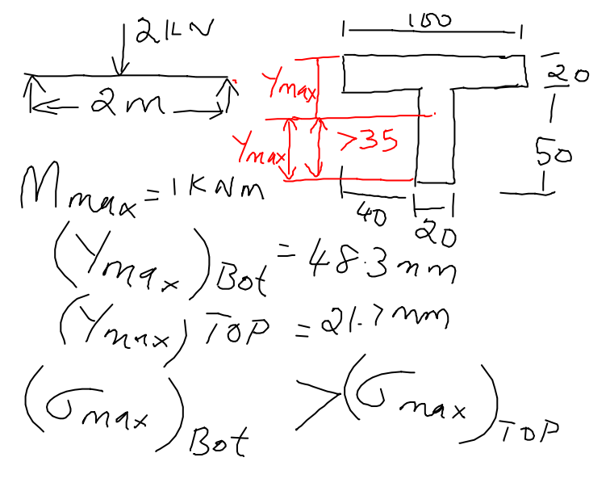
Stress in unsymmetrical cross section beam – “T” CS
Y_{max} is different with respect to topmost and bottommost surfaces and hence stress

Slide 20
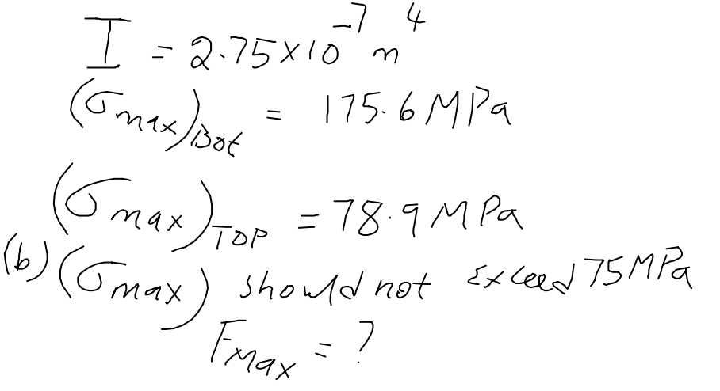
What is the maximum load the beam can withstand? – stress developed should not exceed 75 MPa (condition)

Slide 21
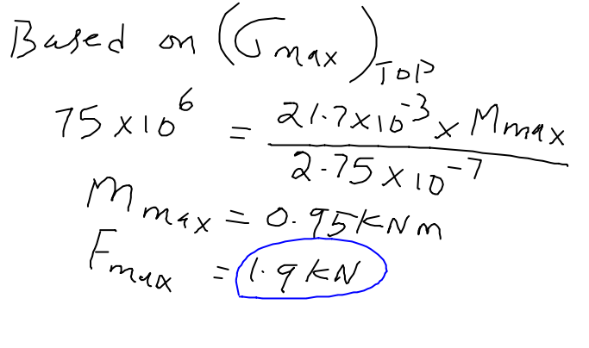

Slide 22
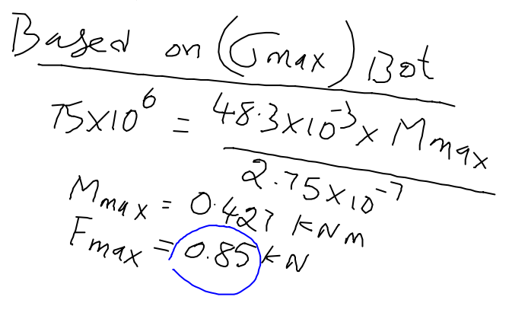

Slide 23
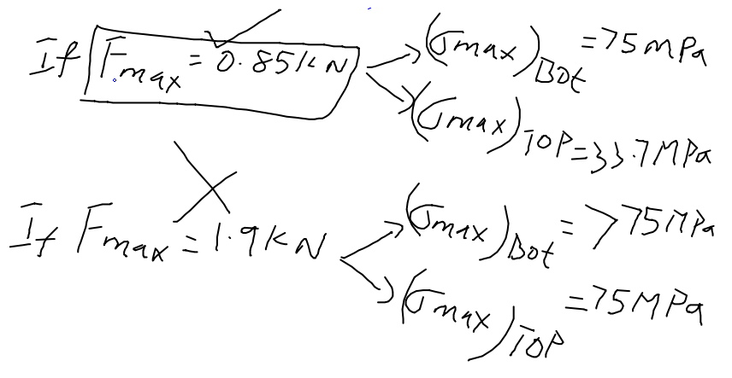
Conclusion: Maximum allowable load is 0.85 kN – both conditions, load is less than (or equal to) 75 MPa. Due to 1.9 kN, bottommost surface develops more than 75 MPa. Hence 0.85 kN is allowable.

Slide 24
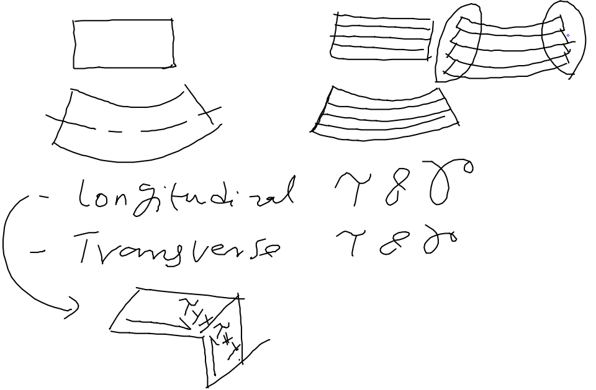
Shear Stress in beam
Deck of cards - 52

Slide 25
Thank you

